Slide 1



Technical assistance from Spain in the framework of the WCO MERCATOR Programme
Customs and Excise Department – Tax Agency - Spain

Slide 2


The accreditation of Spanish experts was carried out in two phases:
1º.- Workshop held in Fortaleza (Brazil)
2º.- Field work carried out in Guatemala

Slide 3
The work to be carried out in Guatemala was developed in two specific phases:
1º.- Study and research at source: regulations, notification of the categories of the Facilitation Agreement, economic development
2º. - Work "in situ".

Slide 4
Cabinet:
The two fundamental aspects:
- Internal customs regulations
- Categories of Trade Facilitation Agreement.

Slide 5

PRESCRIBED DISCIPLINES
Article 1: Publication and availability of information
Article 2: Opportunities for comments, information before entry into force and consultations
Article 3: Advance Resolutions
Article 4: Appeals or review procedures
Notes:
PORTADA

Slide 6
PRESCRIBED DISCIPLINES
Article 5: Other measures to enhance impartiality, non-discrimination and transparency
Article 6: Disciplines in respect of and in connection with duties and charges imposed on Import and Export
Article 7: Release and clearance of goods
Notes:
PORTADA

Slide 7
PRESCRIBED DISCIPLINES
Article 8: Border Agency Cooperation
Article 9: Movement of goods intended for Import under Customs Control
Article 10: Formalities Connected with I, E and T.
Article 11: Freedom of Transit
Notes:
PORTADA

Slide 8

PRESCRIBED DISCIPLINES
Article 12: Customs Cooperation
Article 23.1 Committee on Trade Facilitation
Article 23.2 National Committee on Trade Facilitation
Notes:
PORTADA

Slide 9

MAJOR DIFFICULTIES
Art. 1: Publication and availability of information
1.1.1. d) Rules for the Classification or valuation of products for customs purpose: B
1.1.1. f) I, E or T. restrictions
or prohibitions: C

Slide 10

MAJOR DIFFICULTIES
Art. 1: Publication and availability of information
1.2.1. a): a description of this procedures for I, E or T, including procedures for appeal or review: C
b) the forms and documents required : C
Hardware y Software

Slide 11

MAJOR DIFFICULTIES
Art. 1: Publication and availability of information
1.3.3.1: Information Services: C. Customs Union: B
To establish an
information service

Slide 12

MAJOR DIFFICULTIES
Art. 1: Publication and availability of information
4: Notifications
b) the Uniform Resource Locators of website: B
c) the contact information of the enquiry points: B

Slide 13

MAJOR DIFFICULTIES
Art. 1: Publication and availability of information
The consultation system is not used prior to the publication of the regulation. See if the domestic legislation of each of the countries allows it.

Slide 14

MAJOR DIFFICULTIES
Art. 3: Advance Rulings
3.9: In addition to the advance rulings: B
- the appropriate method or criteria, and the application thereof the valor
Exemptions duties
Tariff, quotas
Additional matters

Slide 15

MAJOR DIFFICULTIES
Art. 5: Other Measures to enhance impartiality, Non-discrimination and Transparency
5.1.: Notifications for enhanced controls or inspections: B
5.2.: Detention: B
5.3: Test Procedures: B
Possibility of using WCO Guidelines on Transparency and Predictability

Slide 16

MAJOR DIFFICULTIES
Art. 6: Disciplines on Fees and Charges…
6.1.4. Each Member shall periodically review its fees and charges with a view to reducing their number and diversity, where practicable: B
Make a comprehensive
study on rights and burdens

Slide 17

MAJOR DIFFICULTIES
Art. 7: Release and Clearance of Good
7.1.1.2: Each Members shall, as appropriate, provide for advance lodging of documents in electronic format for pre-arrival processing of such documents: C

Slide 18

MAJOR DIFFICULTIES
Art. 7: Release and Clearance of Good
7.4.4.3: Each Members shall concentrate customs control and, to the extent possible either other relevant border controls, on high-risk and expedite the release of low-risk consignments: C

Slide 19

MAJOR DIFFICULTIES
Art. 7: Release and Clearance of Good
7.6.6.1 y 2: Establishment and Publication of Average Release Times: C, B
One of the biggest problems encountered and in general in manu countries

Slide 20
MAJOR DIFFICULTIES
Art. 7: Release and Clearance of Good
7.7.3. a): low documentary and data requirements, as appropriate: C.
7.7.3 d): deferred payment of duties, taxes, fees, and charges: C
7.7.3.g): clearance of goods at the premises of the authorized operator or another place authorized by customs: C

Slide 21

MAJOR DIFFICULTIES
Art. 7: Release and Clearance of Good
7.8: Expedited Shipments
7.8.8.2. c), d): Application of franchises and “minimus” depending on the weight and value of the goods. Not only apply to low-value goods: C

Slide 22
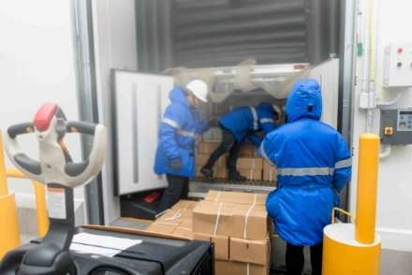
MAJOR DIFFICULTIES
Art. 7: Release and Clearance of Good
7.9: Perishable Goods
7.9.9.3: Each Member shall either arrange or allow an importer to arrange for the proper storage of perishable goods pending their release: C
Problem : urgent shipments current problem worldwide

Slide 23

MAJOR DIFFICULTIES
Art. 7: Release and Clearance Good
Authorizations Authorized Economic Operator:
- promote mutual recognition
- try to establish simpler and simpler methods

Slide 24
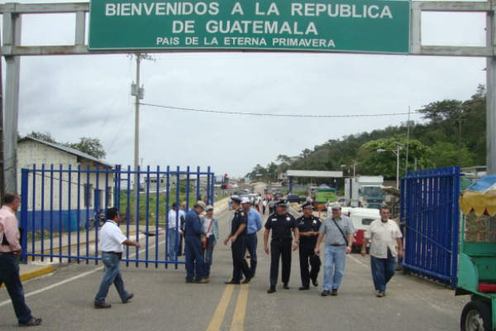
MAJOR DIFFICULTIES
Art. 8: Border Agency Cooperation
8.2: Cooperation between bordering Member States
d) joints controls: C (*)
e) establishment of one stop border post control: C (*)

Slide 25
MAJOR DIFFICULTIES
Art. 10: Formalities Connected with I, E and T.
10.1: Formalities and Documentation Requirements
10.1.1.1. a) Adopted and/or applied with a view to a rapid and clearance of goods, particularly perishable goods: C
b) adopted and/or applied in manner that aims at reducing the time and cost of compliance for traders and operators: C

Slide 26
MAJOR DIFFICULTIES
Art. 10: Formalities Connected with I, E and T.
10.1: Formalities and Documentation Requirements
c) the least trade restrictive measure chosen where two or more alternative measures are reasonably available for fulfilling the policy objective or objectives in question: B
d) not maintained, including parts thereof, if no longer required: B

Slide 27





MAJOR DIFFICULTIES
Art. 10: Formalities Connected with I, E and T.
10.4: Single Window: C (**)
Increased control Temporary import, inward and outward processing
ECONOMIC OPERATOR
…

Slide 28
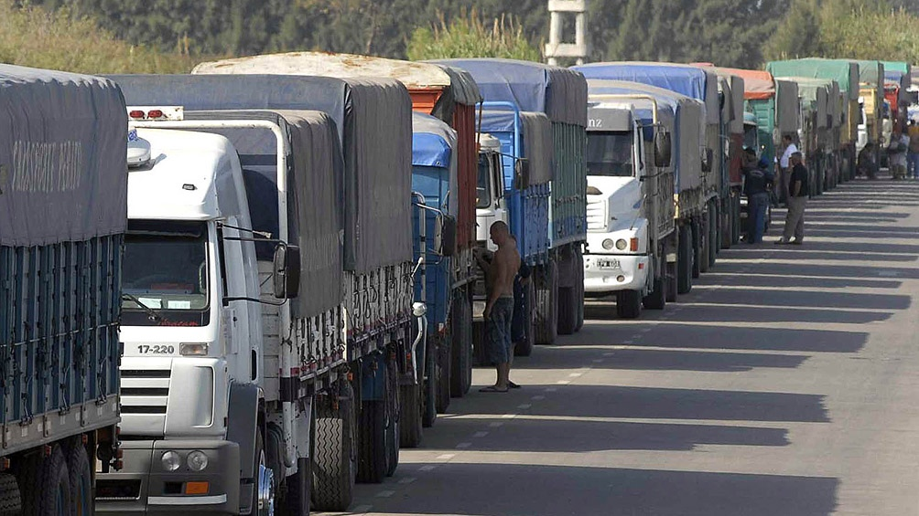
MAJOR DIFFICULTIES
Art. 11: Freedom of Transit
11.1.7: Once the transit has begun, not subject to loads, delays or restrictions until its destination: B
Appoint a national and regional coordinator if possible

Slide 29

MAJOR DIFFICULTIES
Art. 12: Customs Cooperation (**): C
Exchange of Information
Verification
Request
Protection and Confidentiality
Provision of Information

Slide 30
MAJOR DIFFICULTIES
Art. 12: Customs Cooperation (**): C
Postponement or Refusal of a Request
Reciprocity
Administration Burden
Limitations
Unauthorized Use or Disclosure
Bilateral and Regional Agreements

Slide 31

MAJOR DIFFICULTIES
Art. 12: Customs Cooperation (**): C
Analysis of legal limitations

Slide 32
MAJOR DIFFICULTIES
Art. 23: Committee on Trade Facilitation
Shall be led by Customs
More participation of companies
Poorly participatory state agencies
Change of personnel
To establish a Permanent Secretariat: to prepare works, tables of specialists, to give continuity ...

Slide 33

MAJOR DIFFICULTIES
Bring each Member State's domestic legislation into line with the TFA

Slide 34

Final report
Submission to the Trade and Customs authorities

Slide 35


Spanish Tax Agency
www.agenciatributaria.es
Thank you for your attention

